Slide 1

A PSA on the PSA: Big Team Science with the Psychological Science Accelerator

Slide 2



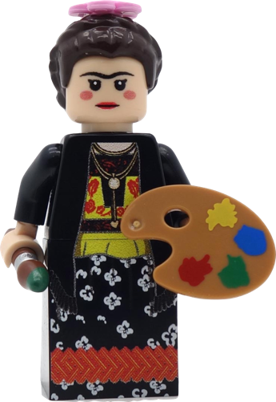


Big Team Science

Slide 3

Example Projects
Reproducibility Project: Cancer Biology
Reproducibility Project: Psychology
Many Smiles Project
Many Labs
And more!

Slide 4




Example Teams
Psychological Science Accelerator
ManyBabies Consortium
ManyPrimates project
Collaborative Replication and Education Project

Slide 5

Replication
Notes:
https://gizmodo.com//everything-you-always-wanted-to-know-about-lego

Slide 6







Generalizability

Slide 7





W.I.E.R.D. Science
Notes:
Western, Educated, Industrialised, Rich, Democratic

Slide 8


Slide 9
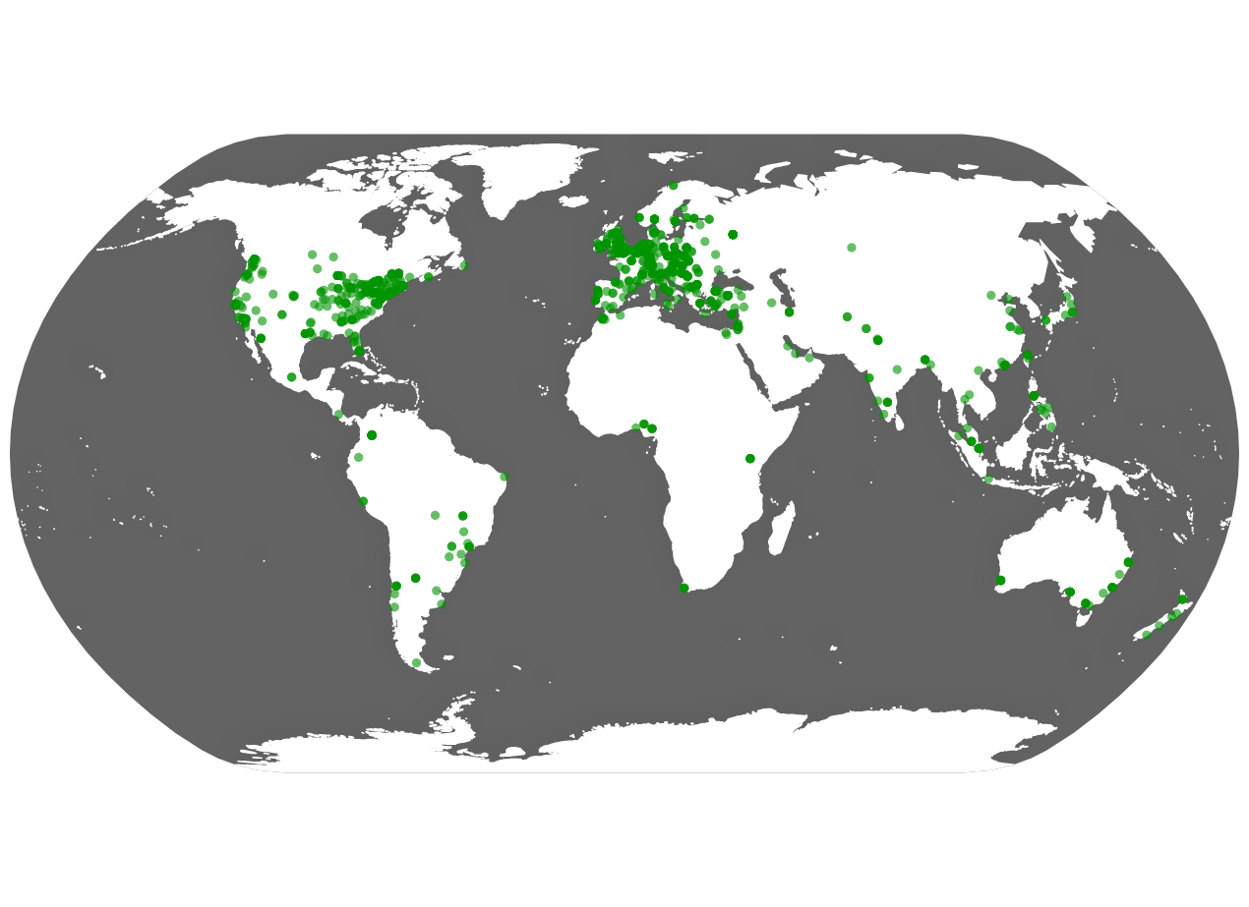

Slide 10






Psychological Science Accelerator
Director
Associate
Directors
Assistant
Directors
Members
Interns

Slide 11
Psychological Science Accelerator
Leadership Team
Study Selection
Community Building & Network Expansion
Project Management
Ethics
Translation & Cultural Diversity
Data & Methods

Slide 12
PSA Process
Submission and Evaluation
Feasibility Review, Identify Reviewers
Submission Review
Preparation
Finalize Protocol
Establish Collaboration Agreement
Make Final Decisions
Translation and Ethics

Slide 13
PSA Process
Implementation
Pre-registration
Data Collection
Data Management
Analysis and Dissemination
Confirmatory Analyses + Exploratory Analyses
Manuscript Submission

Slide 14
Study | Nickname | Status | Authors | Langs | Countries | N
PSA001 | Social Faces | published | 243 | 25 | 44 | 12660
PSA002 | Object Orientation | under review | 115+ | 18 | 18 | 3743
PSA003 | Gendered Prejudice | under review | 115+ | 18 | 18 | 3500+
PSA004 | True Belief | published | 135+ | 12 | 19 | 9275
PSA005 | Stereotype Threat | data analysis | 44+ | 1 | 1 | ~2500
PSA006 | Trolley Problem | published | 155 | 27 | 45 | 27502
PSA007 | SPAM-L | RR Stage 2 | 350+ | 30 | 41 | ~35K
CR001 | Loss Gain | published | 455 | 42 | 87 | ~27K
CR002 | Cognitive Reappraisal | published | 455 | 42 | 87 | 27989
CR003 | Self Determination | published | 483 | 42 | 89 | 25718

Slide 15






SPAM-L
Erin Buchanan
(Harrisburg University of Science & Technology, USA)
R&R at Nature Human Behaviour
Can we find semantic priming across languages?
PSA007
Notes:
PSA007: Erin Buchanan (Harrisburg U of Sci & Tech, Pennsylvania)
semantic priming relies on reliable, well-studied stimuli with defined similarity values.
Create an online framework to collect semantic priming data
Provide a database of response latencies and priming scores for words in 5-9 of the 9 languages with available frequency data

Slide 16


Semantic Priming
Faster
Slower

Slide 17
Semantic Priming
Semantic priming has a rich history in cognitive psychology
The Semantic Priming Project (Hutchison et al., 2013) provided priming values for 1661 English word-pairs
Semantic priming replicates (mostly) consistently – so why more studies?
Single language focus or multilingual individuals
A lack of data sets that are matched on language within one study
WEIRD words

Slide 18
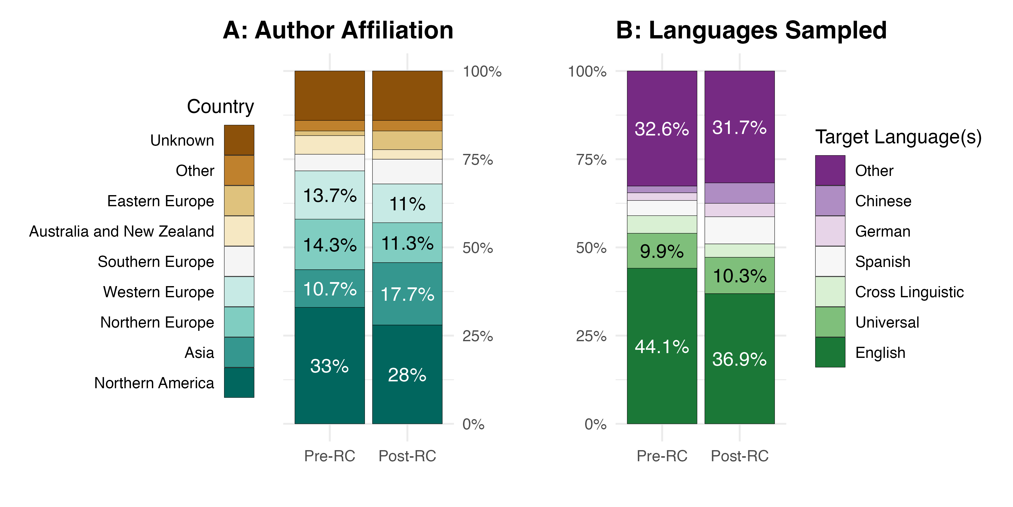
Linguistics is WEIRD

Slide 19
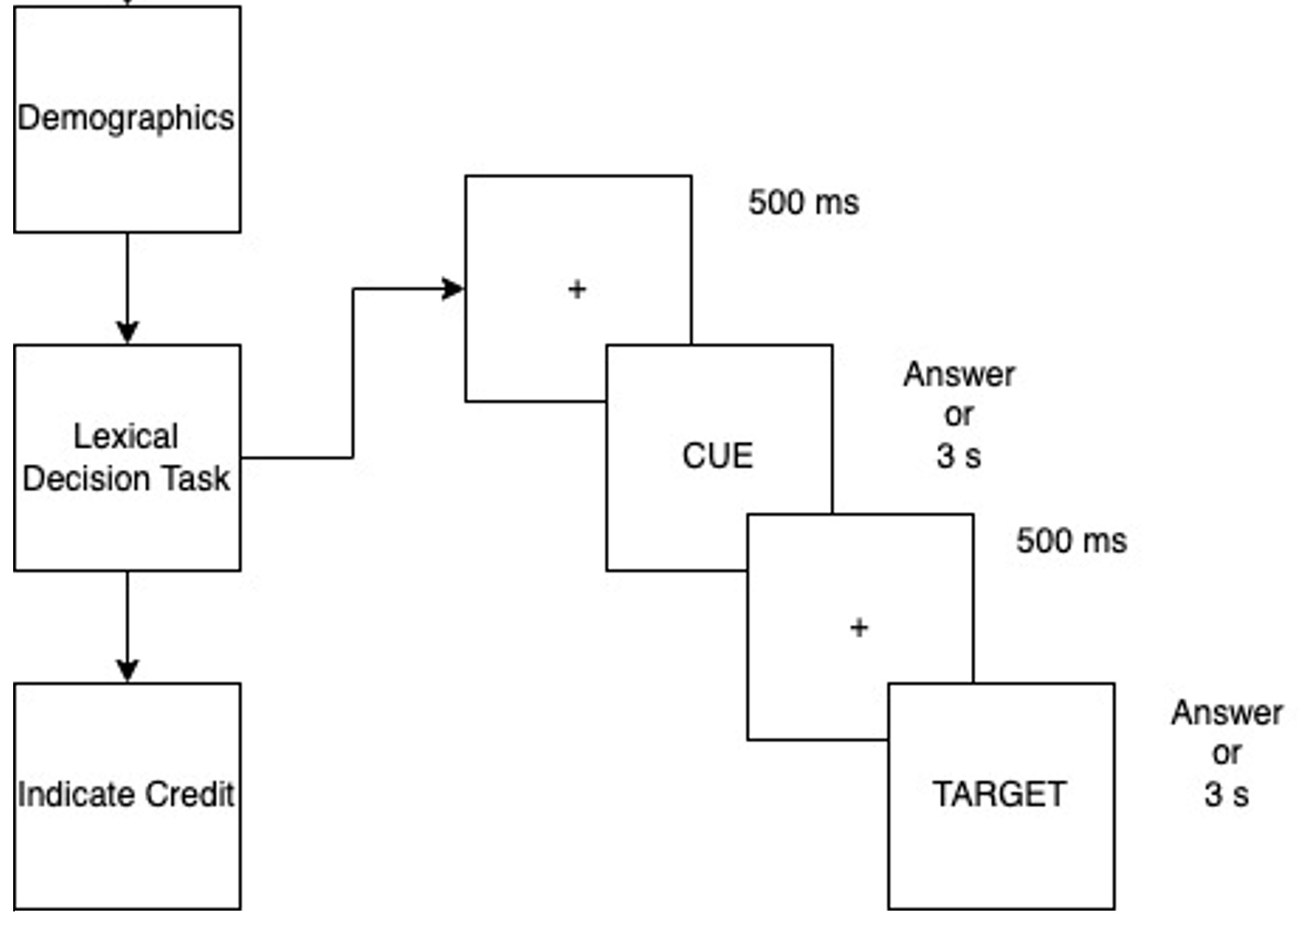
Study Procedure
https://psa007.psysciacc.org/

Slide 20
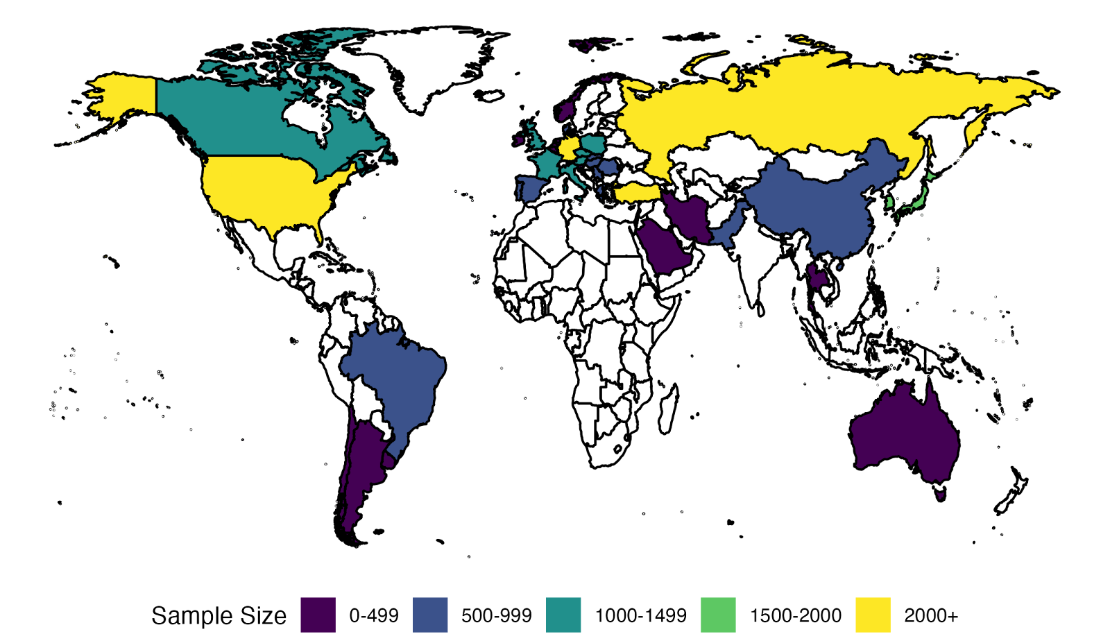
Data Collected

Slide 21
Languages
Brazilian Portuguese, Czech*, Danish, English*, French, German*, Greek, Hungarian, Italian, Japanese*, Korean*, Portuguese (European)*, Polish, Romanian, Russian*, Serbian, Simplified Chinese*, Spanish*, Turkish*
Arabic, Dutch, Farsi, Hebrew, Hindi, Norwegian, Slovak, Slovenian, Thai, Traditional Chinese, and Urdu

Slide 22
Stimuli
5000 matched trials:
1000 related
1000 unrelated
3000 nonword – word or nonword – nonword combinations
Stimuli were selected by using the languages relatedness and then matched across language

Slide 23
Participants and Labs
126 research labs
31,645 participant sessions total with at least one trial
25,163 participants analyzed for the manuscript

Slide 24
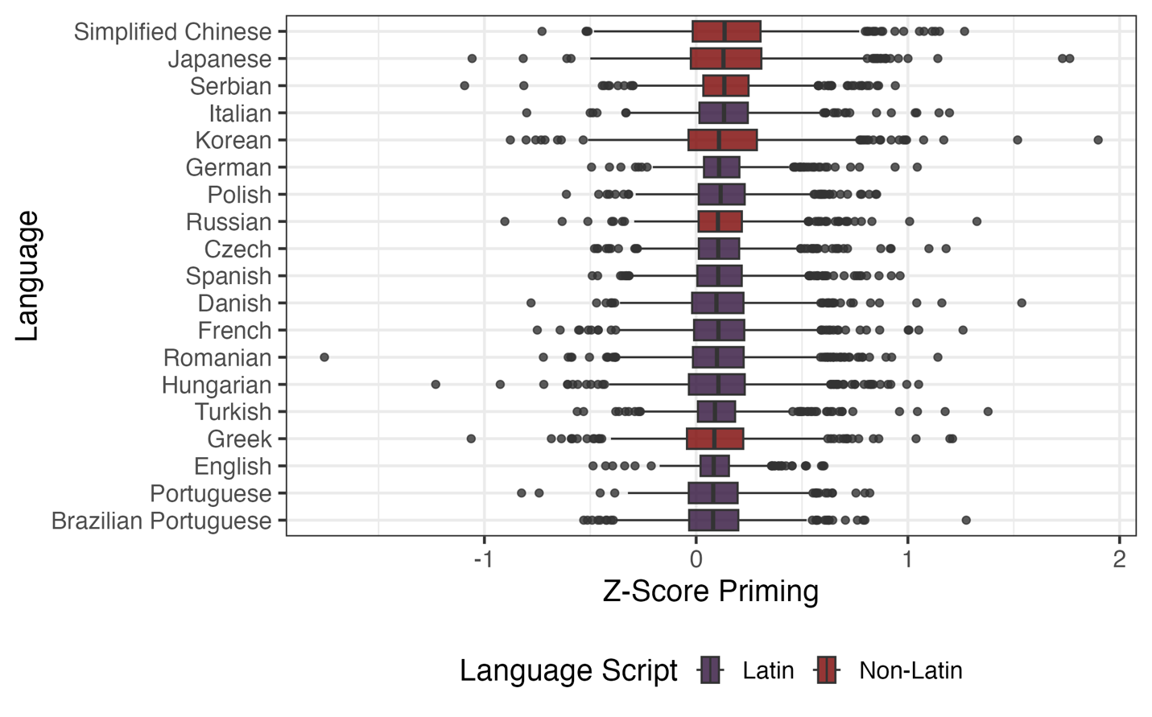
Priming Results

Slide 25
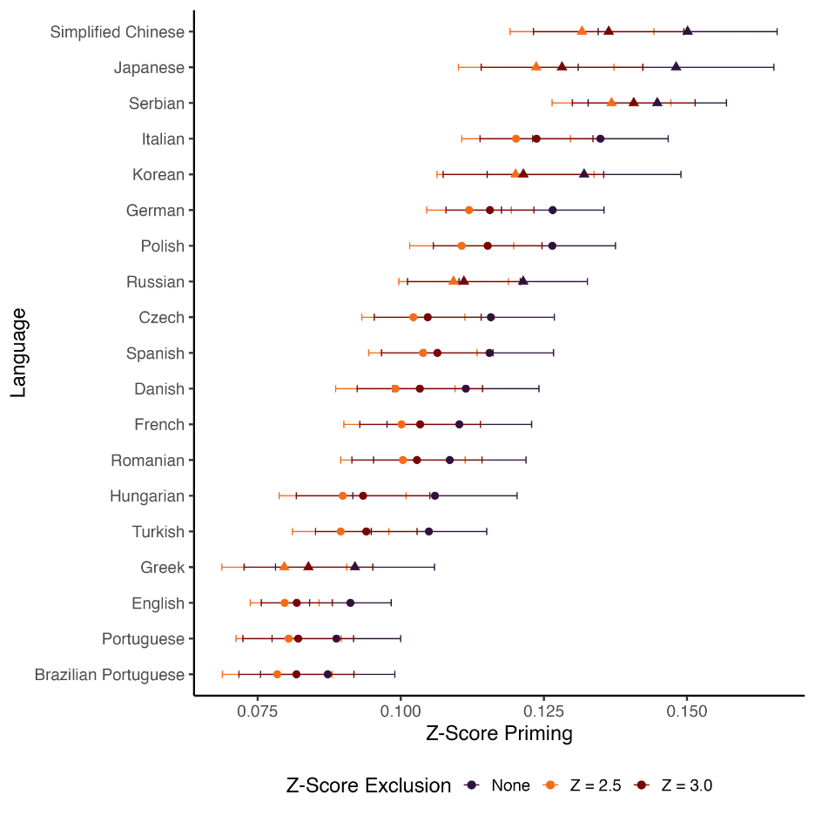

Slide 26
SPAML Summary
Largest priming study to date and the largest collection across languages
Priming was found in all languages
Variability between languages was small but consistent
More cool projects coming soon with the data

Slide 27

Lessons Learned from SPAML
How do you manage so many people?
Tracking students after they graduate
IRBs across the globe
Translation

Slide 28
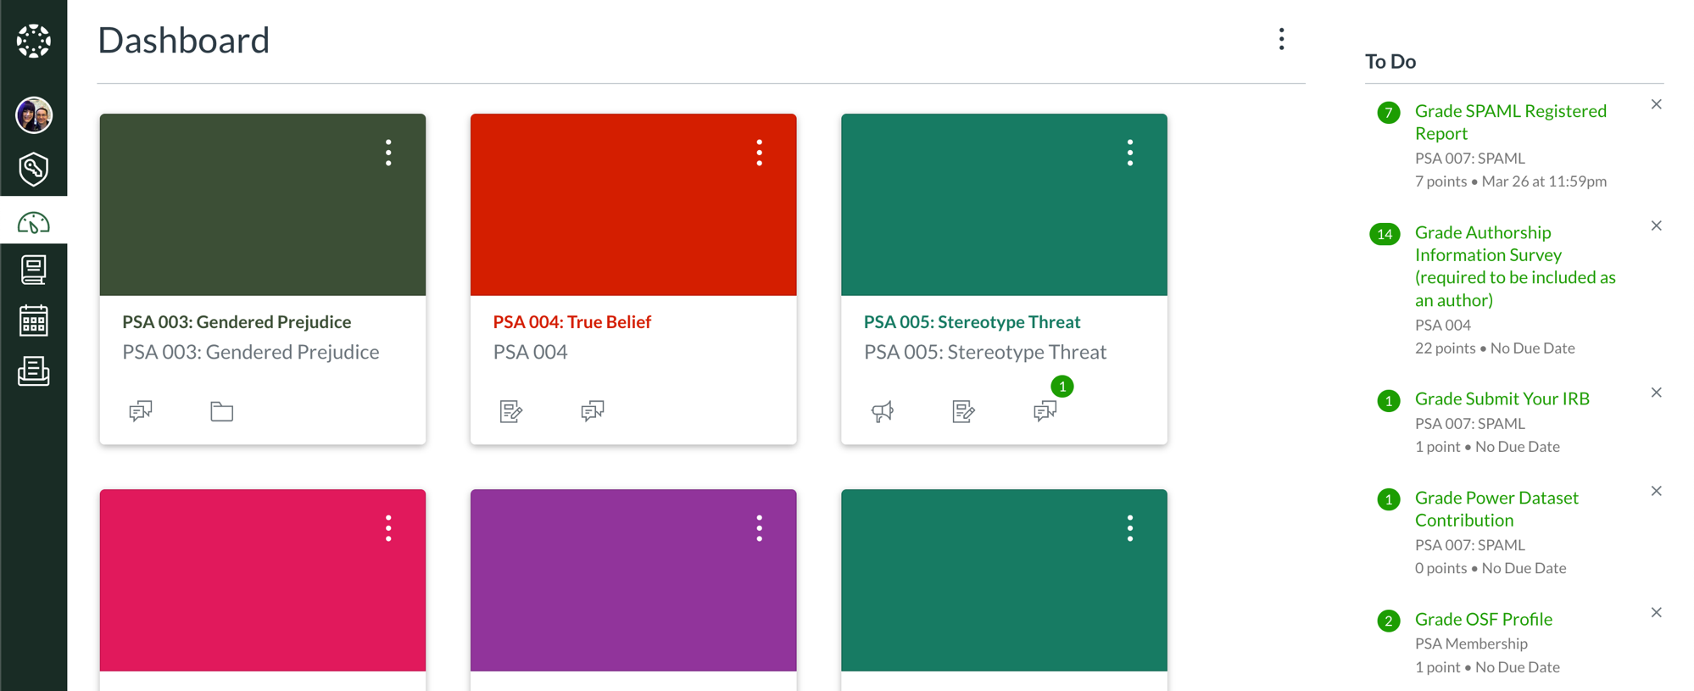

Slide 29



STAPLE

Slide 30
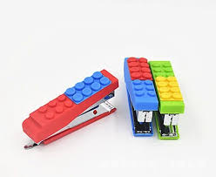
STAPLE Mission
Science Tracking Across the Project Lifespan
Project Management software that allows you to document your project to improve transparency
Check it out at: https://staple.science

Slide 31

Summary
Big Team Science is on the rise in the social sciences
Groups collaborate on best practices
A catch-22: as we get better at this, we expect more from teams
Good science is worth the trouble!
Software to the rescue

Slide 32

Thanks to Lisa DeBruine for the Lego Slides

